Slide 1
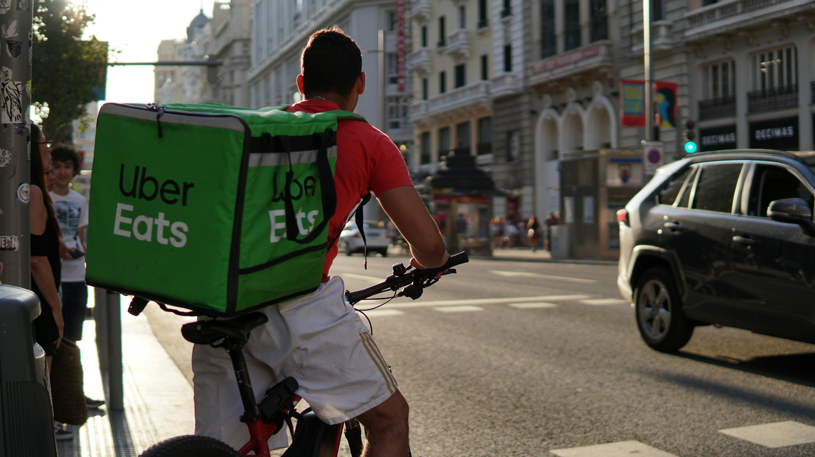
Case Study on Duplicate detection using GenAI
By: Daryll Dalmeida

Slide 2
Case Statement & Project Goal
Problem Statement: Merchant product catalogs often contain duplicates and inconsistencies, creating a poor customer experience and increasing manual workload for Catalog Ops. We need an automated, scalable solution to detect and remove duplicates while ensuring high catalog quality.
Customer Impact: This leads to increased customers dissatisfaction, incorrect substitutions & higher chances of error.
Goal: Our goal is to develop an automated, GenAI-driven solution to accurately identify and resolve duplicate product listings at scale. This will ensure a cleaner, more reliable catalog that improves the customer experience and reduces manual operational efforts.
Data source: The catalog dataset has 128038 records across various categories, brands, packages, units and orders.

Slide 3
Data Cleaning Strategy
Overview: Standardize Name, Brand, Package, and Category into a single, comparable record so we can safely detect duplicates.
Why should we normalize & standardize the data?
Implementing these steps on our catalog dataset allows us to :
Removing the stop words lets us match on what is important— product name, package, brand, category, size— so we catch duplicates more accurately.
We clean the product name so it’s consistent: make it lowercase, remove accents (e.g., azúcar → azucar), and drop filler words. ( eg: Before : Atún en agua UN 6 u x 160 g c/u , After : tun agua 6 x 160 g).
After implementing these steps we were able to clean up 88% of the data by choosing each column. The remaining 12% was not captured during the normalization so we created an updated unit conversions dictionary & well as separate functions for single pack & multi-pack to capture all the types of units & packages.
Merged these standardized brand + product name + category name + package into a canonical form containing all information.

Slide 4
Feature Engineering
This is a process of creating new features that could be important to the project
Similarity Score
Bucket Type
Action
In this step, we would be creating a function that uses fuzzy matching to generate a similarity score using the original product name without changes and the standardized product name with the changes.
Fuzzy matching measures scores between two product names for identifying duplicates in a system.
The bucket type is created using the similarity score feature.
The logic used here is as follows :
1. High bucket : Similarity score > 95
2. Medium bucket : Similarity score >75 & <95
3. Low bucket : Similarity score < 75.
This is a great feature to add because it groups all scores into three main buckets.
The Action feature is derived from the bucket type.
The logic here is that each bucket has a different representation and action.
1. Auto merge on High Bucket: We should be auto-merging them as duplicates if found in high bucket.
2. Human in the Loop for Medium bucket: This is crucial to our team since it needs review.
3. Unique / Ignore : Scores that are below 75 may be considered after HITL.

Slide 5
Insights from Standardization
Field | Total Rows | Before Standardized | After Standardized | Uppercase left | Accents left
Product Name | 128,038 | 75 (~0.06%) | 127,963 (~99.94%) | 0 | 0
Package | 128,038 | 57,711 (45.07%) | 70,327 (54.93%) | 0 | 0
Brand | 128,038 | 29,934 (23.38%) | 98,104 (76.62%) | 0 | 0
Category | 128,038 | 0% | 100% | 0 | 0

Slide 6
AI Prompt Strategy
Purpose: Design a scalable global AI prompt framework that detects and classifies duplicate catalog items accurately across languages, scripts, and measurement systems.
Prompt Overview
The idea behind creating the prompts revolved around 3 main catalog techniques –
PACK SIZE DETECTION
ATTRIBUTE INFERENCE
IMAGE VALIDATION
Why does Retail Grocery focus these catalog techniques?
Based on research, pack size helps in optimizing inventory management & the system can also alert the team when products run out of stock.
Attribute inferencing would help in enhancing the quality of the catalog to a great extent by generating more accurate substitutions when products are low.
Millions of SKUs are uploaded in an online retail catalog daily & image validation helps detect the right product which enhances accuracy.

Slide 7
AI Prompt Evolution Strategy
Prompt Version | Prompt Function | Output
Version 1 : Start with a basic prompt | Eg : Tell me if product a and product b are duplicates or not? | LLM will provide an answer based on what they interpret but can be wrong too.
Version 2: Prompt with constraints | Eg : Use the rules mentioned in the prompt & tell me if both products are duplicates or not? | LLM will now have a better response and accuracy will be slightly better than previous response.
Version 3 : Prompt with specific product attributes | Eg : Using brand name, and other product info identify the pack size of the product and classify as duplicate or not? | LLM will give a very accurate response and will try to find the closest match possible.
Version 4 : Prompt using a different language for Global Scaling | Eg : By using localized units specific to each language, it will detect based on the query we ask. | This will help us scale globally if we provide localized stop words, units, etc.
Version 5 : Using different catalog detection techniques | Eg : Extract count * size and normalize units from: ‘Pack x 12 cerveza corona botella 355 ml’ | This will help us reduce the false merges that happen across the catalog.

Slide 8
AI Prompt Classification Logic Workflow
Step 1: Add prompt rules for normalization & Standardization(e.g 3l to 3000ml)
Step 2: Comparing Attributes/Standardization
Brand comparison
Unit comparison
Attribute comparison
Step 3: Add prompt rules, if product name| brand| package = Different then classify as ‘Not Duplicate’
Step 6: Action
> 95 = Enters system
< 95 & >75 – Human review
< 75 = Unique product
Step 4:Check similarity score of products that are close match of each other.
Step 5: Prompt decision with explanation for generated output

Slide 9
Detecting Duplicate Types
Type 1 : Same product, different packaging
Type 2 : Same brand, minor misspellings / variant
Type 3 : Same unit, synonyms for size
Type 1 Duplicates Count : 27687
Type 2 Duplicates Count : 9323
Type 3 Duplicates Count : 938

Slide 10
INSIGHTS

Slide 11
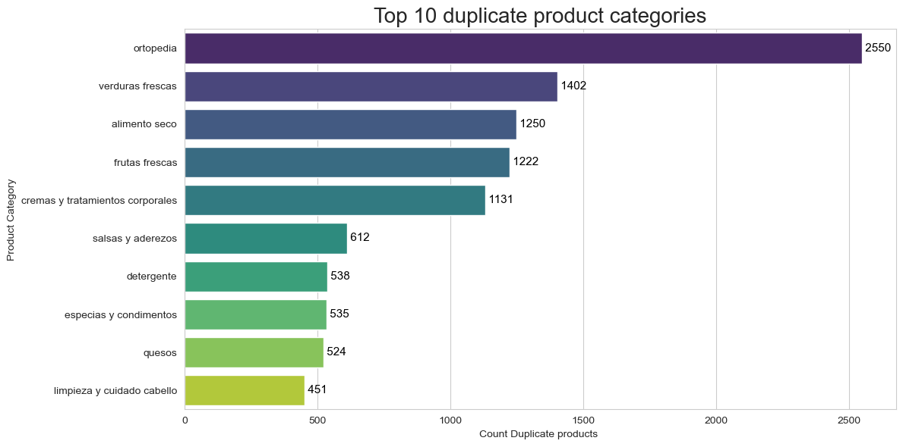
Adding Visualizations to Duplicates
Insight: Ortopedia has the highest number of duplicates than any other category. Verduras frescas , alimento seco are the 2nd and 3rd highest categories having duplicates in their products.

Slide 12
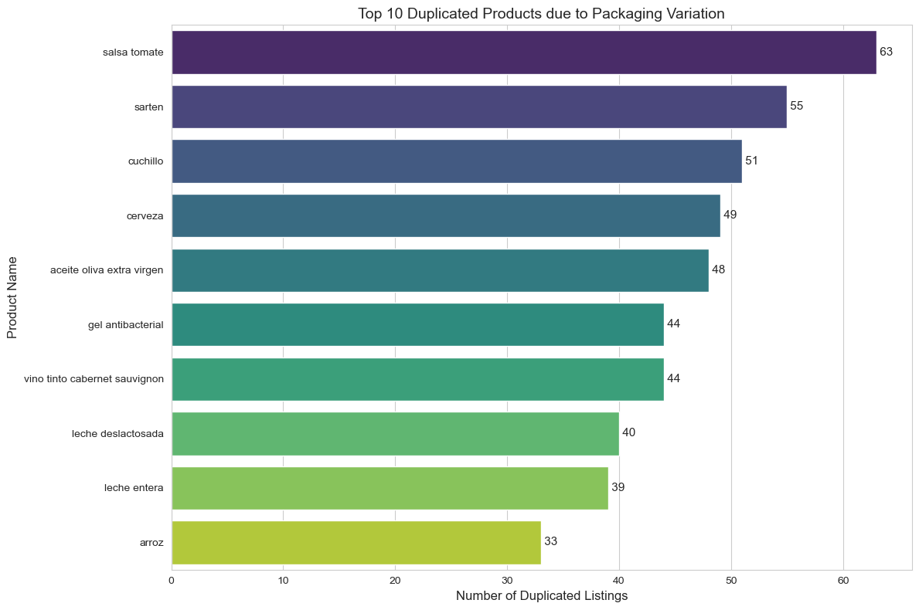
Adding Visualizations to Duplicates
Insight: This graph shows us a detailed view on how each duplicated product does in terms of packaging variation. ‘Salsa tomate’ product name is the highest with 63.

Slide 13
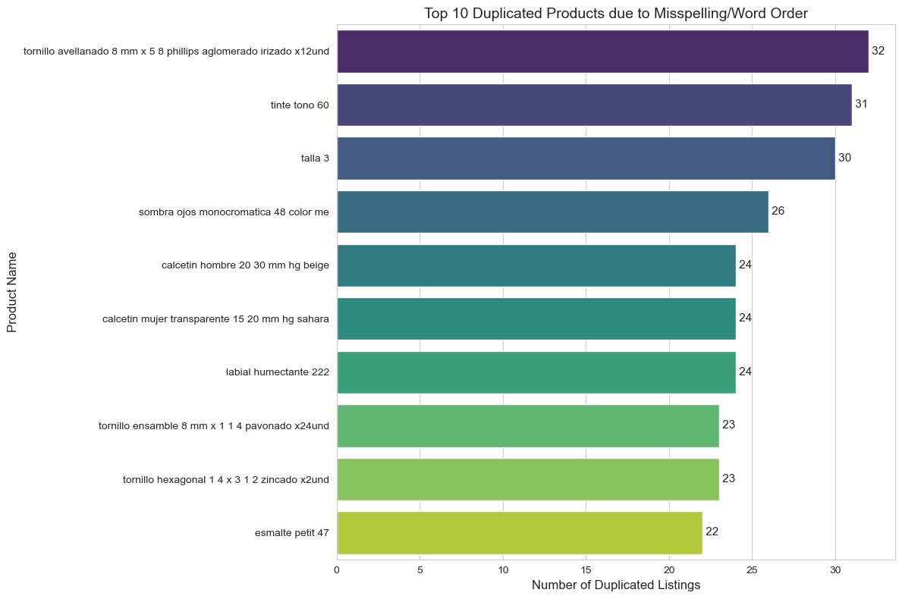
Adding Visualizations to Duplicates
Insight: This graph shows us a detailed view on how duplicated product names due to misspelling(Type 2 duplicates).

Slide 14
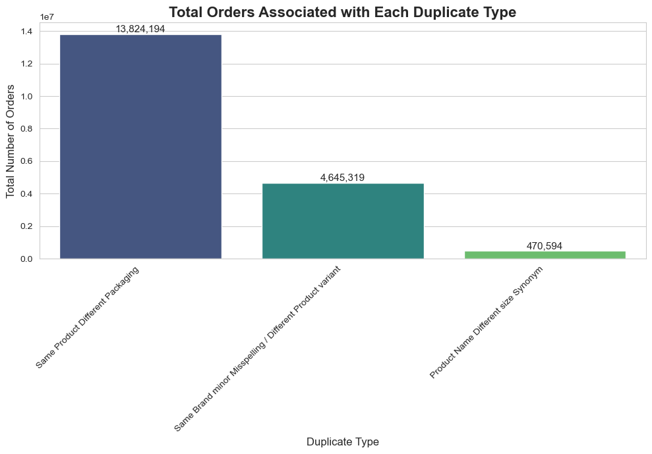
Adding Visualizations to Duplicates
Insight:
This view shows us most number of orders for each duplicate type.
Highest orders were placed for Type 1 duplicates followed by Type 2 and Type 3.

Slide 15
Before & After Product name changes
 | Before changes | After changes
0 | Atún en aceite | atun aceite
1 | Atún en aceite de girasol | atun aceite girasol
2 | Atún Van Camps Lomitos En | atun van camps lomitos
3 | Pescado tomate | pescado tomate
4 | Atun Lomitos En Aceite X 140 gr | atun lomitos aceite x 140 g
5 | Atún Van Camps Maíz & | atun van camps maiz
6 | Atún Van Camps Lomitos En | atun van camps lomitos
7 | Salmon En Trozos Al Natural | salmon trozos natural
8 | Pack x12 cerveza andina light lata 330m | pack x12 cerveza andina light lata 330ml

Slide 16
Fixing the Catalog
Question: How would you fix this catalog and decrease the number of duplicated products you found?
Step 1: Catch duplicates before they even enter the catalog.( Cleaning/Standardizing converting units etc).
Applying a set of rules and then using GenAI to automate the process by catalog detection techniques.
Step 3: Removing bad data at the origin by informing merchants about product catalog standards & formats.
Step 2: Having Human in the zone
Similarity score checker is a great way to do that as it allows us to review parts of the catalog for fixes.
Step 4: Continuous monitoring of catalog using product insights, trends and detecting duplications using GenAI.

Slide 17
Fix Recommendations
Scaling the project globally is ambitious & this means that we know and identify our duplicates well enough for it to give us a great accuracy & also build a scalable workflow. Global scaling means confidently spotting duplicates in any language (≥95% precision) and running a simple, repeatable process.
Solution 1: Multi-Lingual Hybrid Retrieval-Augmented Generation (RAG) approach
Solution 2: Rule based duplication for high volume SKUs
Solution 3 : Geo-Localized Synonym Dictionaries
Solution 4: Merchant Training to Standardize naming conventions.

Slide 18
Multi-Lingual Hybrid Retrieval-Augmented Generation (RAG) approach
1
Strategy : Ingesting a Hybrid RAG into the duplication process would help evaluate each new incoming product based on language, brand, category, unit differences, etc.
Benefits :
This would massively help us in analyzing similarity scores, flagging duplicates, & also scaling it to global countries irrespective of language.
My suggestion is that this approach can yield a highest accuracy while scaling globally.
Cons :
Since this operates on larger datasets, the cost can be high.

Slide 19

Rule-Based Duplication for High-Volume SKUs
Strategy : We need to ensure that high selling SKUs are always present to the customer or else that can cause pain points to them leading to dissatisfaction. By having a set defined rule system or rule playbook, we can identify those high volume SKUS by auto – merging them into the system leading to faster launches.
2
Benefits :
Faster launches from merchant into the system preventing customer dissatisfaction.
Cheaper at cost & also easier to implement.
Cons :
Some products may escape the rules due to the rules not capturing all types of permutations and combinations.(High Precision & Low Recall)

Slide 20
Geography based localization for products
Strategy : We can build synonym dictionaries for each country we want to scale the project into. We take shopper feedback based on top brands/SKUs and start a pilot program in a specific market we want to target with a set precision achievement plan.
Benefits :
This can widen our market base and can help us diversify our portfolio.
It would also reduce the workload on Ops team as we create different dictionary maps here, that would be reusable for different countries.
3
Cons :
Incorrect data mapping may lead to inconsistencies across markets.
Cost can be high since it needs to scale globally.

Slide 21
Merchant training to standardize naming conventions
Strategy : My strategy for this crucial step would be to educate the merchants in a way that we are able to get the first step prioritized before even moving to improving the catalog quality.
For this , we could set up frequent training calls with them & provide a short demo of how we would want our dataset to be in. Giving them an example demo would be great because it would help them understand how we interpret the data and that would help us get rid of the columns that we do not need or that are not relevant to our analysis.
Before they upload their data, we can create a validation tool that lets us have a checker list before we even start with the data preprocessing.
This will allow us to collab with our Engineering teams to be our Merchant pipeline where we have a script ready to be provided to the Merchants that way whenever they enter a SKU/product that is already existing in the system, our system can flag it in real time to them saying that this is a potential duplicate product.
4

Slide 22
THANK YOU!!!

